Slide 1
Criticality Safety at the Y-12 National Security Complex
Kevin Reynolds
Kevin.Reynolds@cns.doe.gov
Director, UPF Nuclear Safety

Slide 2

Go VOLS!

Slide 3
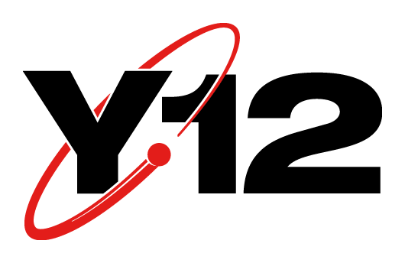
Outline
Introduction
History of Y-12
Y-12 Facilities
Y-12’s Mission
Processes at Y-12
NCS Engineer Roles

Slide 4
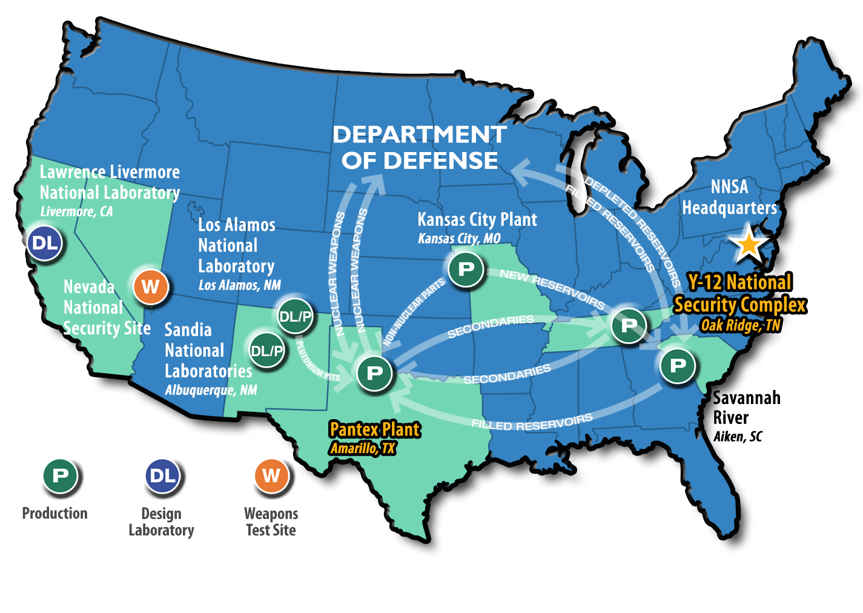
Introduction
Department of Energy Nuclear Weapons Complex

Slide 5
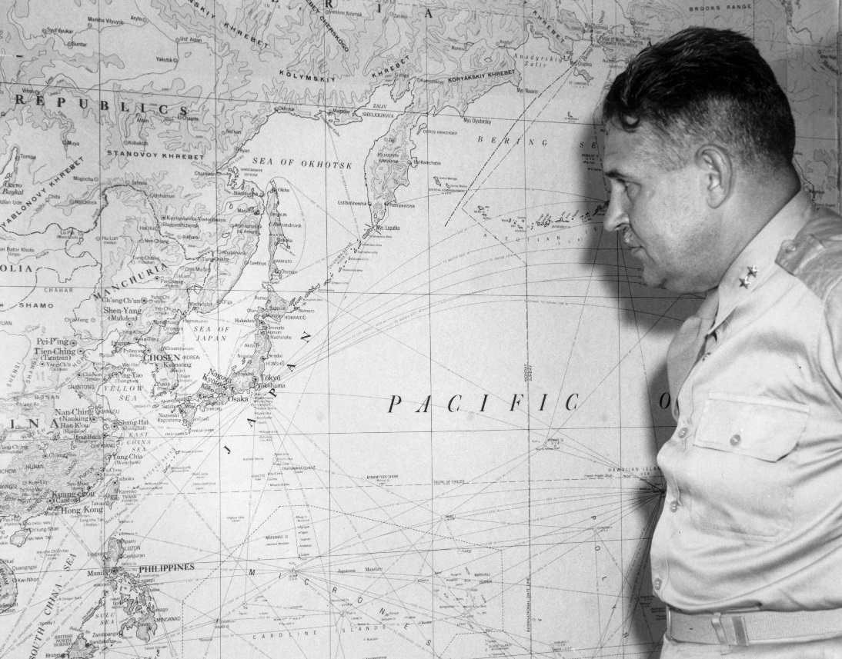
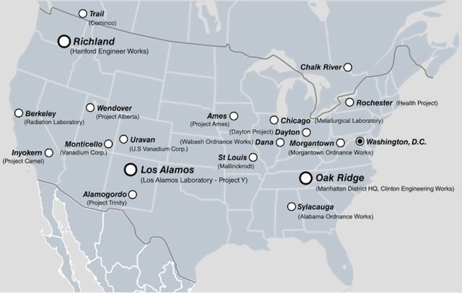
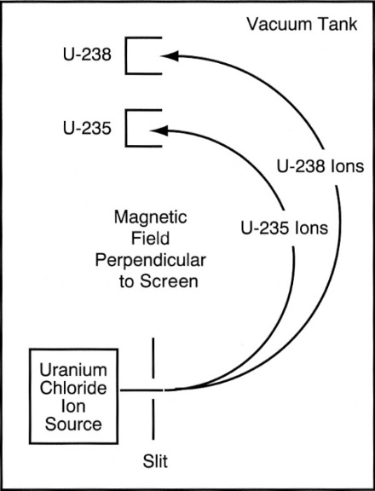
History of Y-12
Manhattan Project
Electromagnetic Enrichment of Uranium
Notes:
Discuss calutrons and level of material enriched
Started in 1943, material for little boy by August 1945

Slide 6
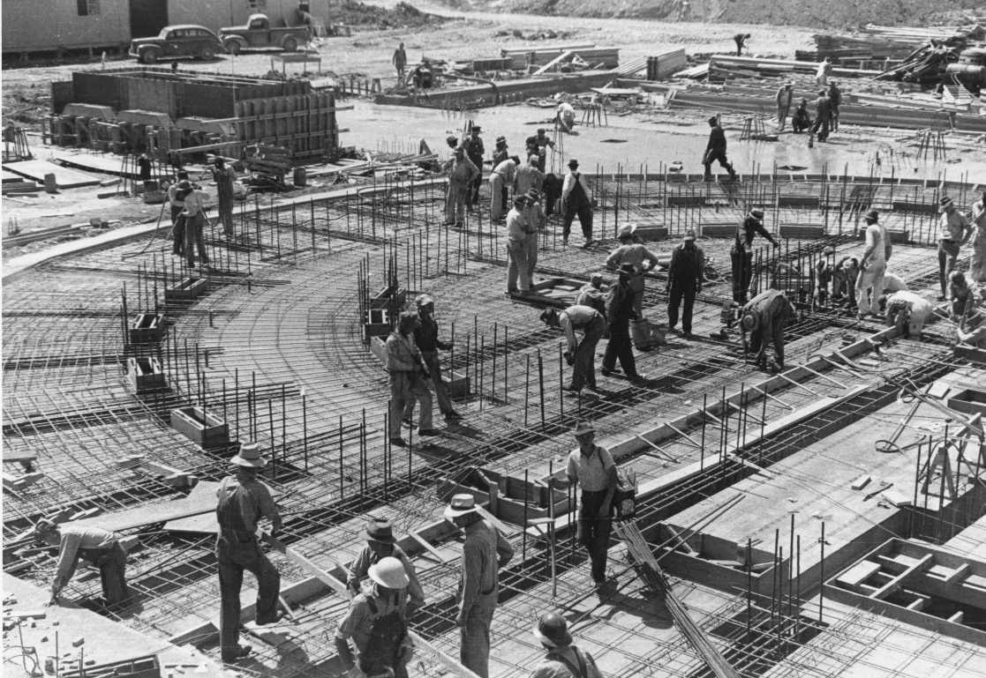
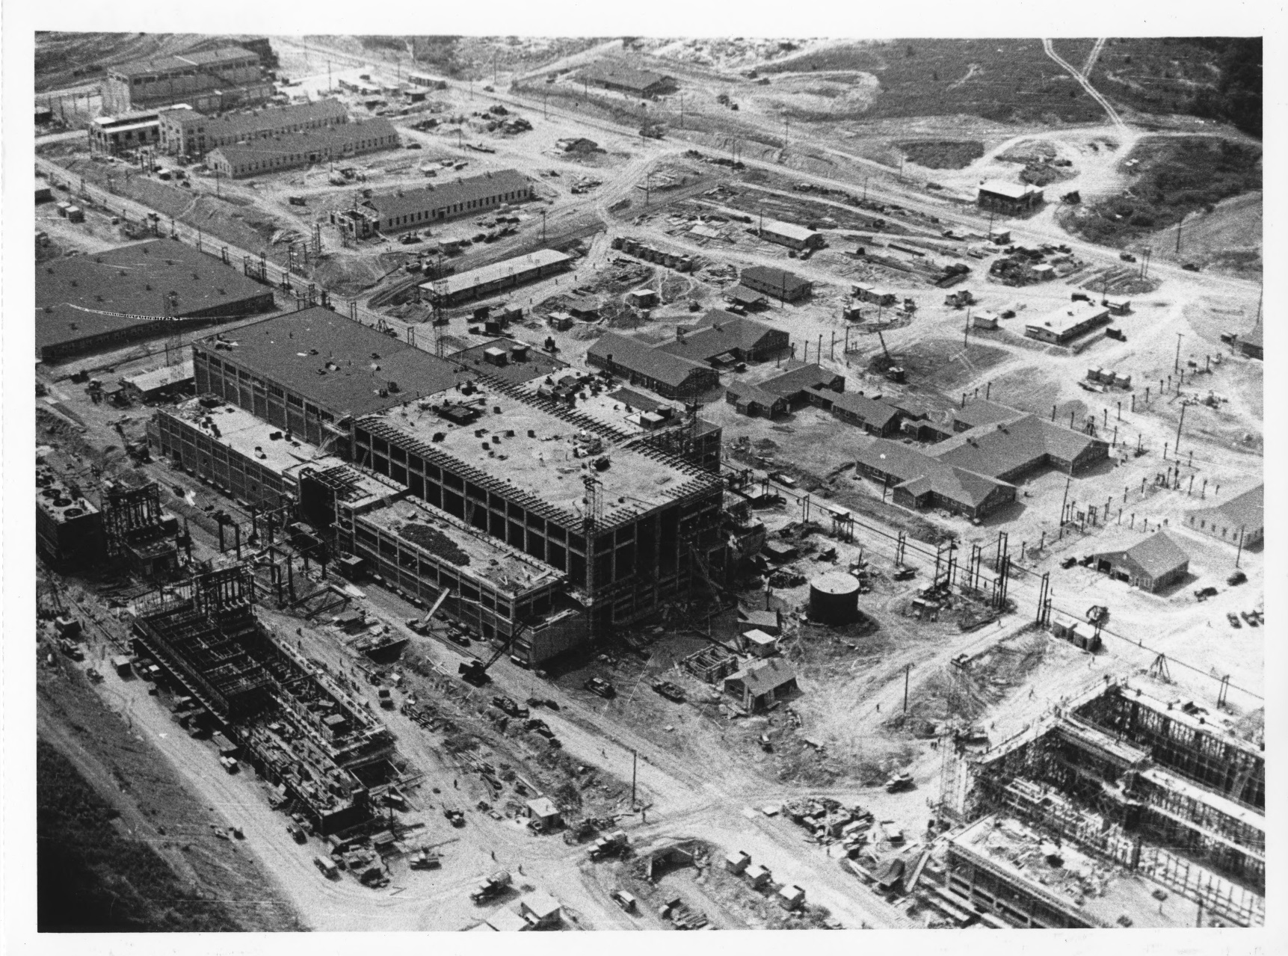
History of Y-12
Notes:
Number of calutron facilities built

Slide 7
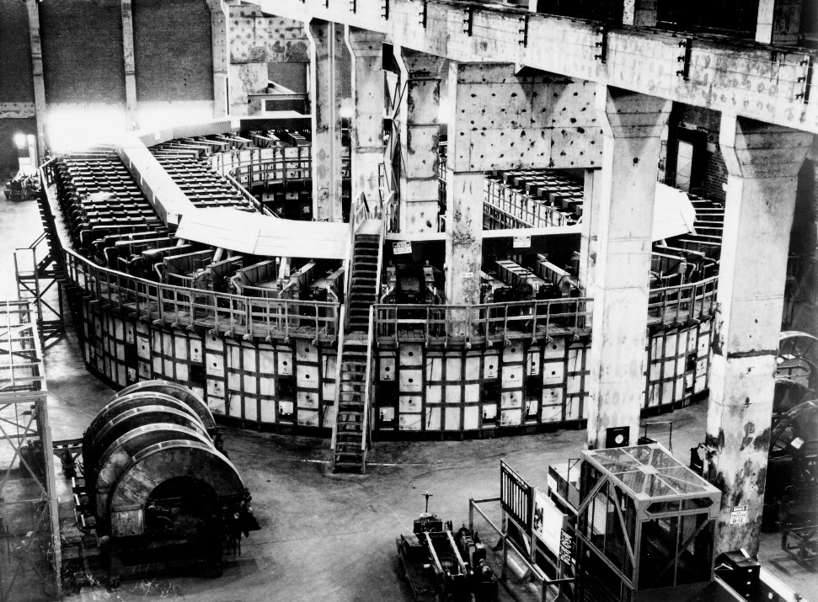
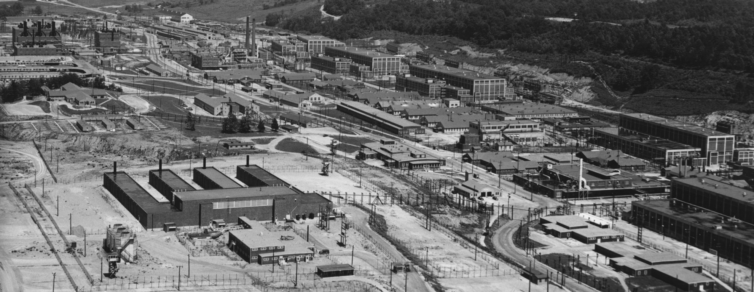
History of Y-12
1945
Enrichment Facilities
Chemical Recovery
Analytical Laboratories
Notes:
Discuss calutrons and level of material enriched
Started in 1943, material for little boy by August 1945

Slide 8
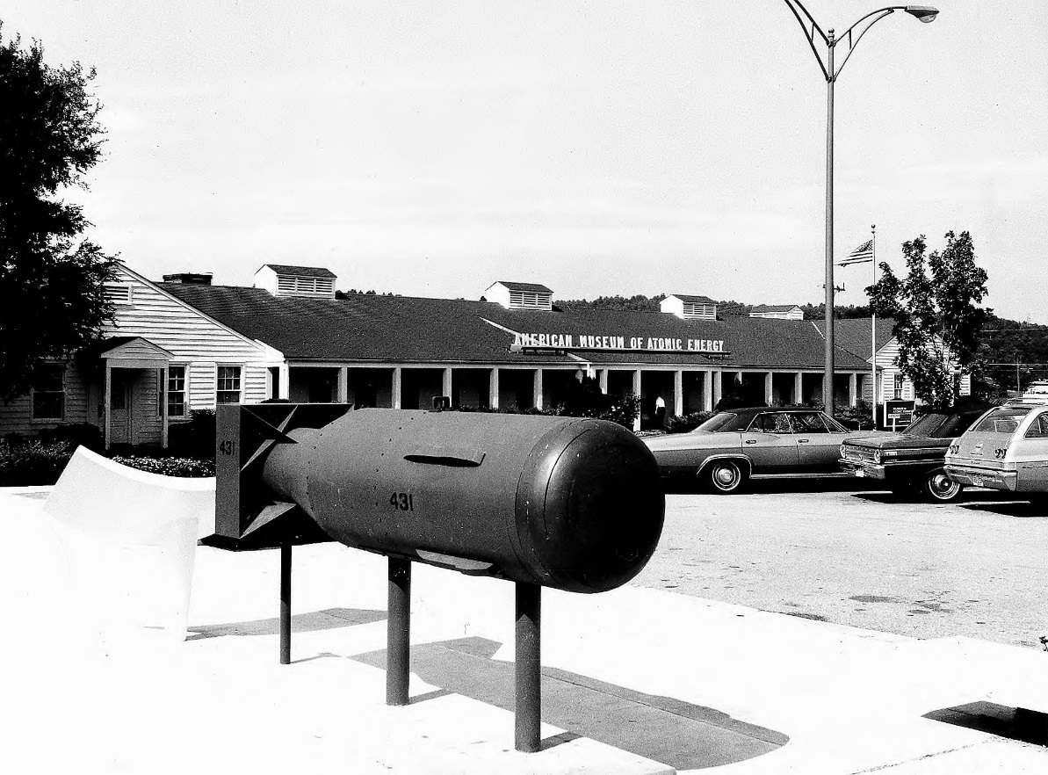
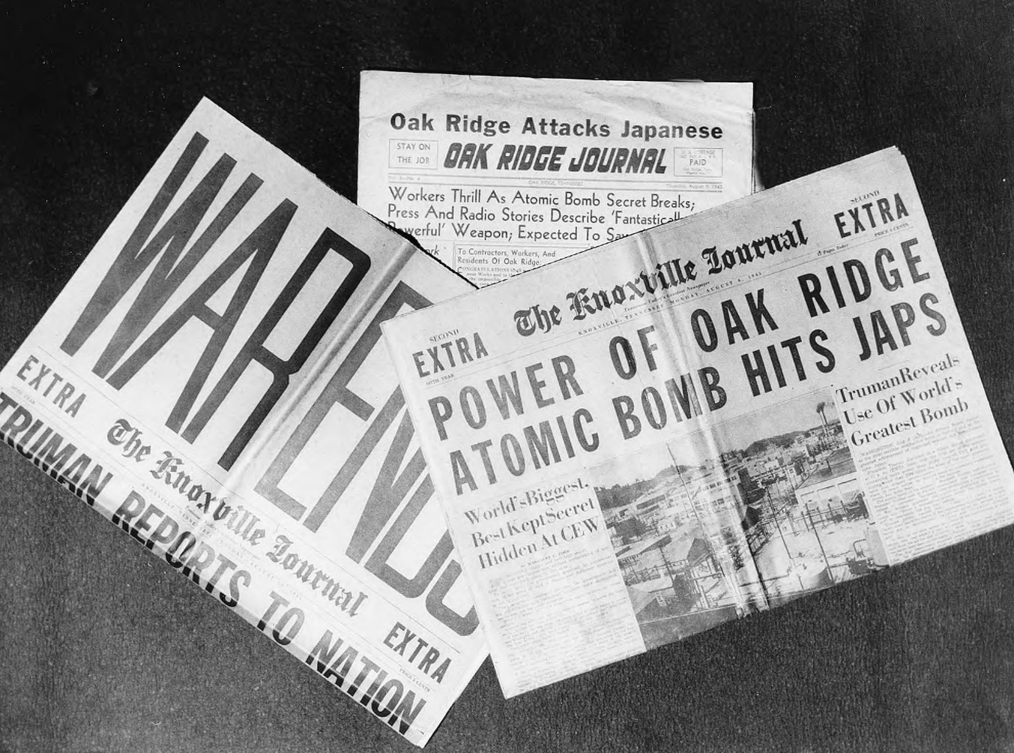
History of Y-12
Y-12 efforts helped end World War II
Notes:
Enriched uranium from Y-12 shipped to los alamos

Slide 9
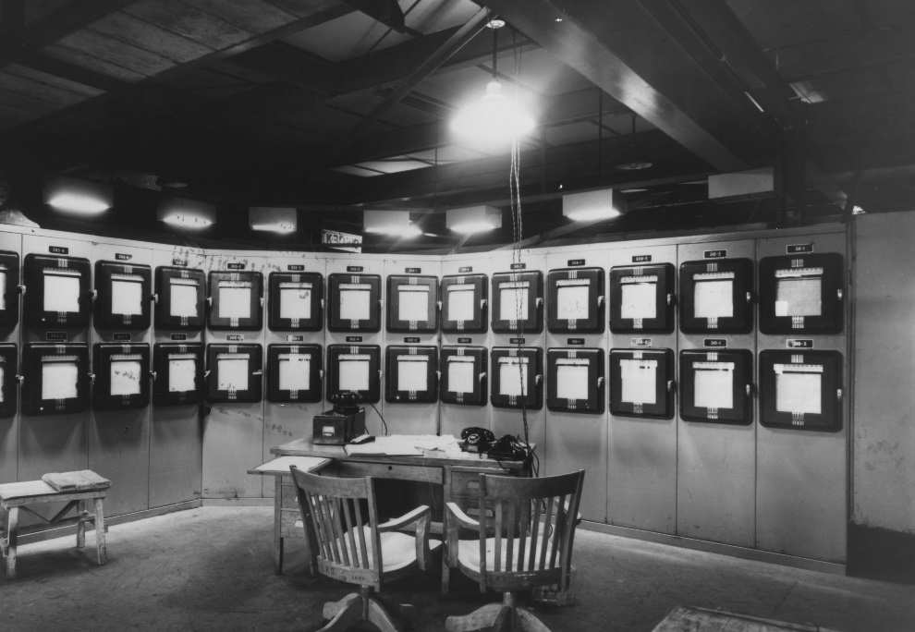
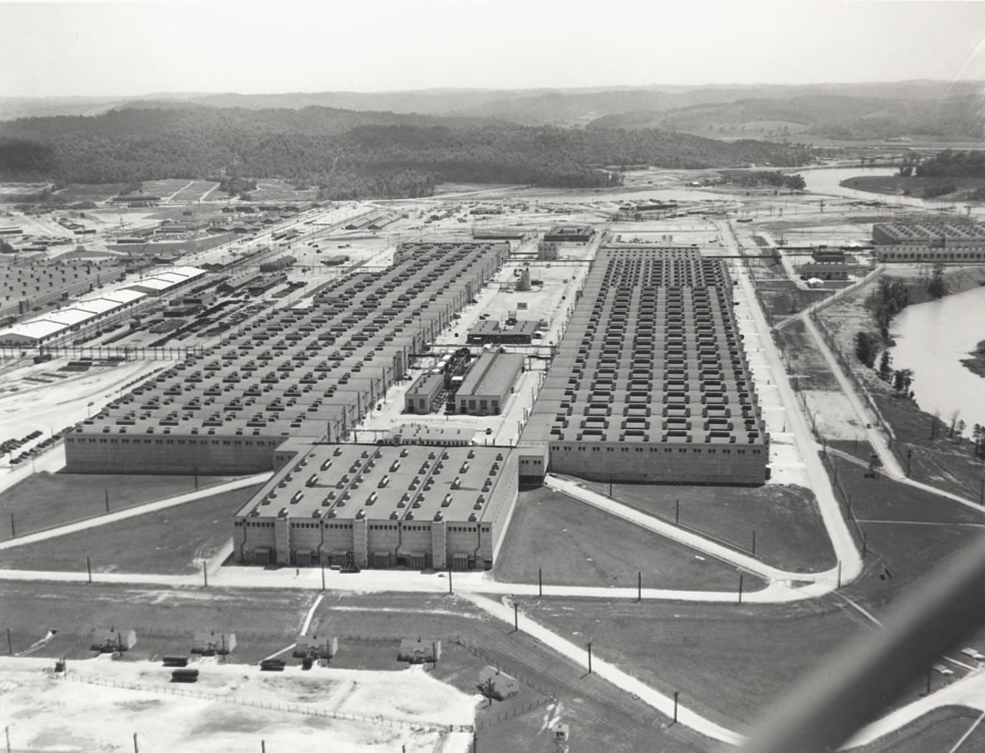
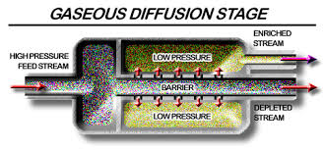
Change in mission
Enrichment at GDP preferred (K-25 site)
Notes:
Post 1945 still need for EU
Arms race with USSR
Need more enriched uranium

Slide 10
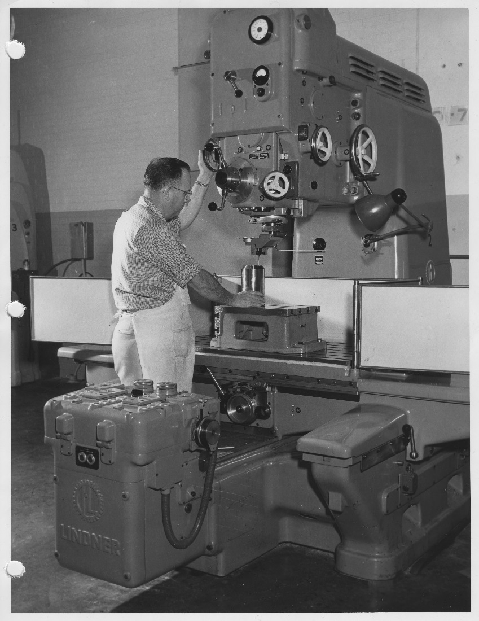
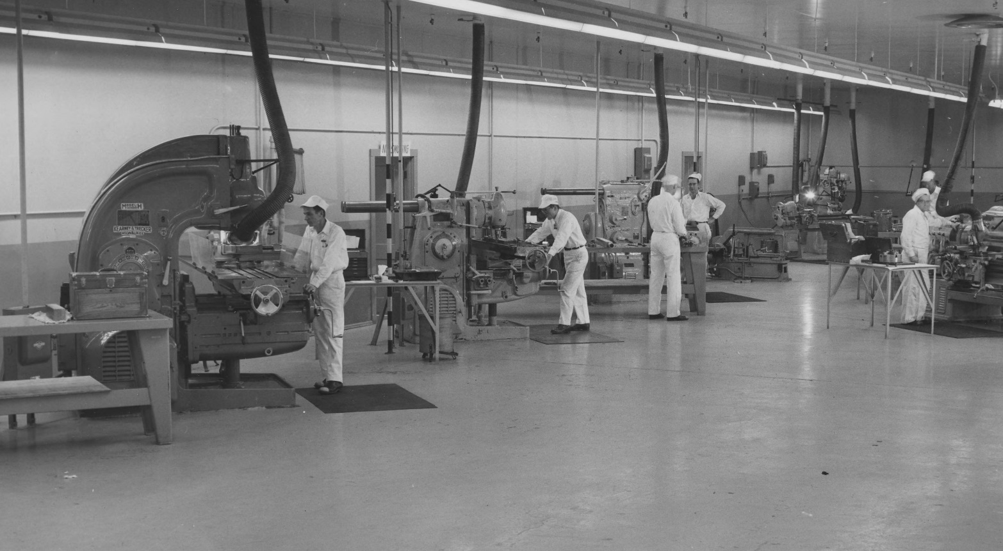
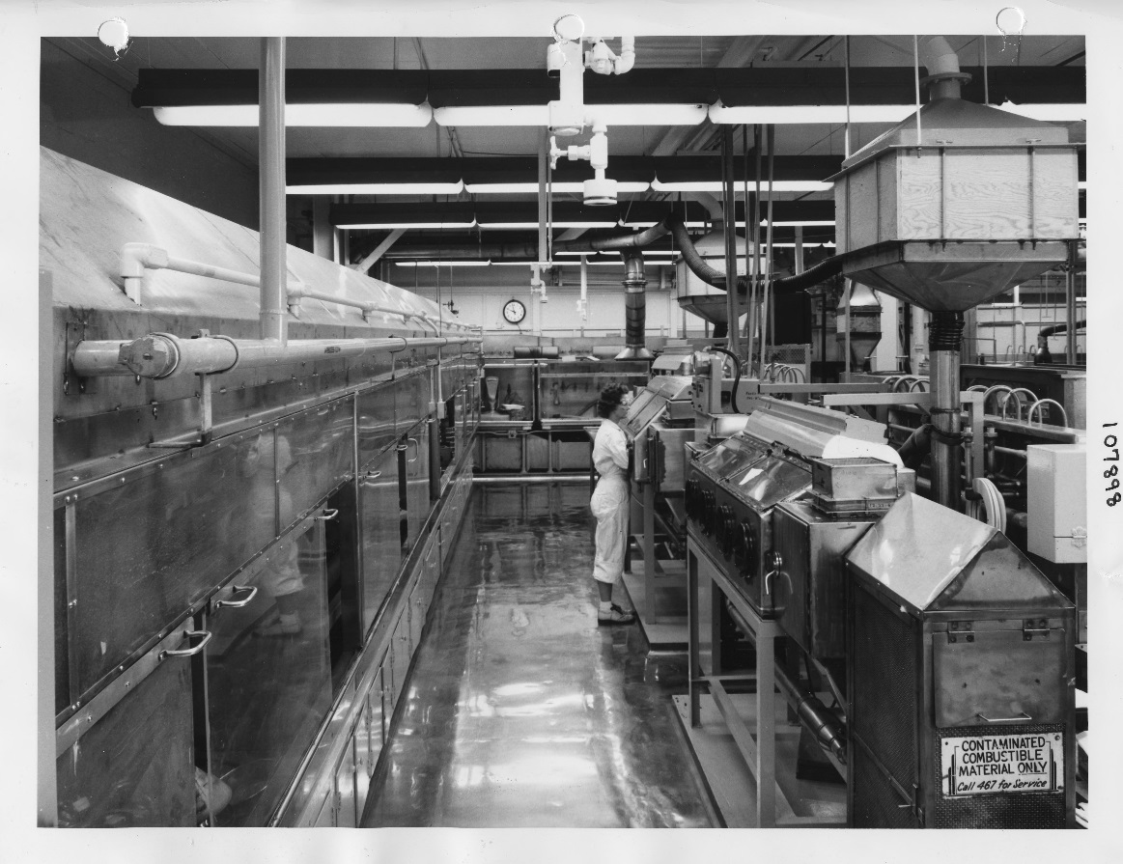
Change in mission
1950-1960
Y-12 transitions from enrichment to weapons part manufacturing
Notes:
Y-12 reinvents itself
Foundry operations
Part fabrication with highly specialized machine
Expand chemical recovery
Special production

Slide 11
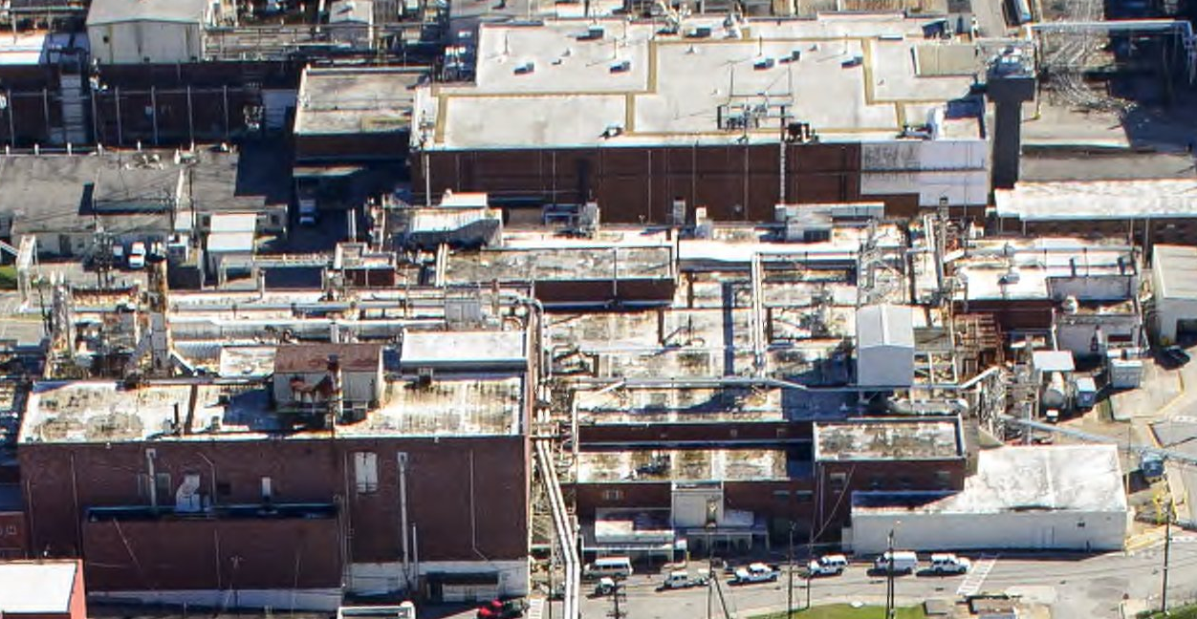
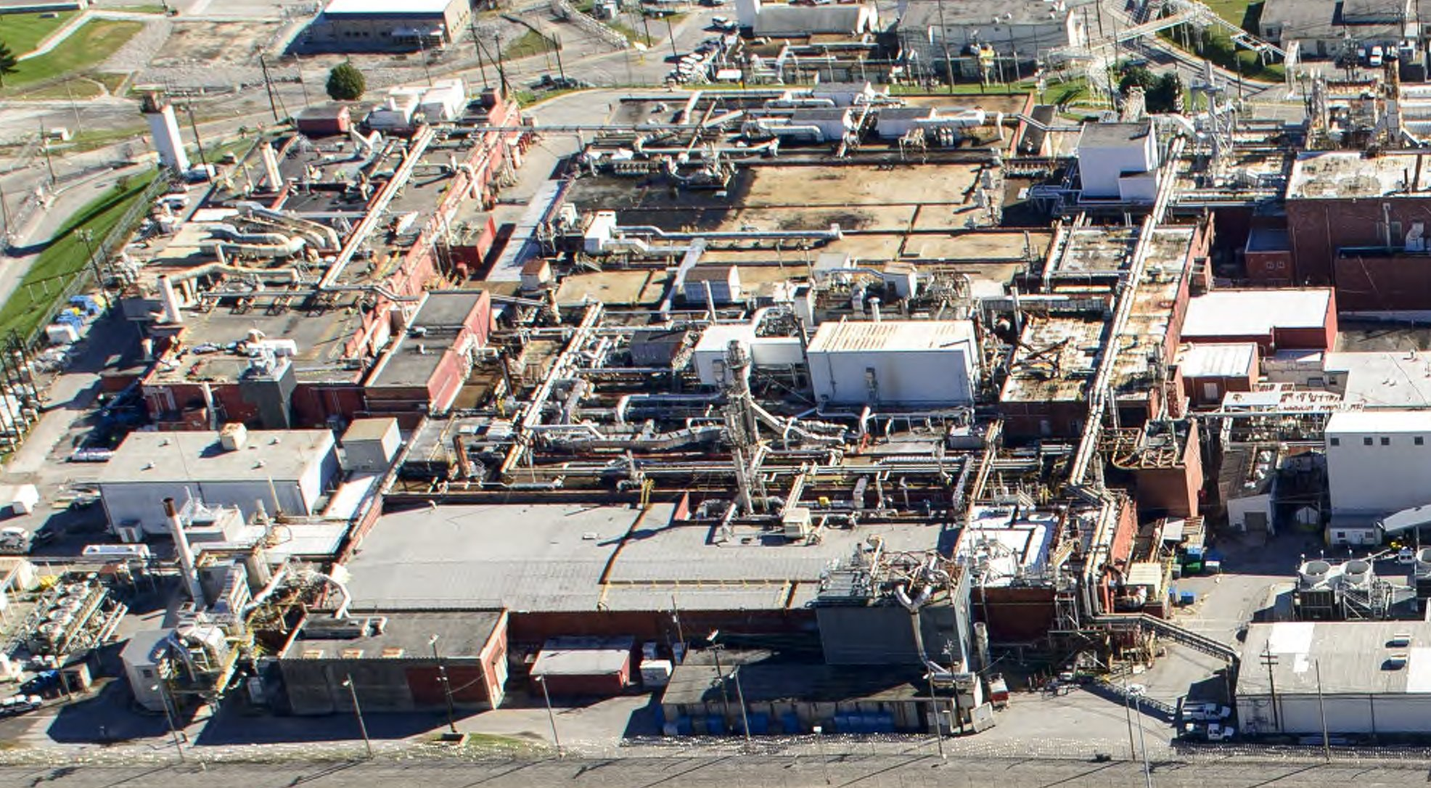
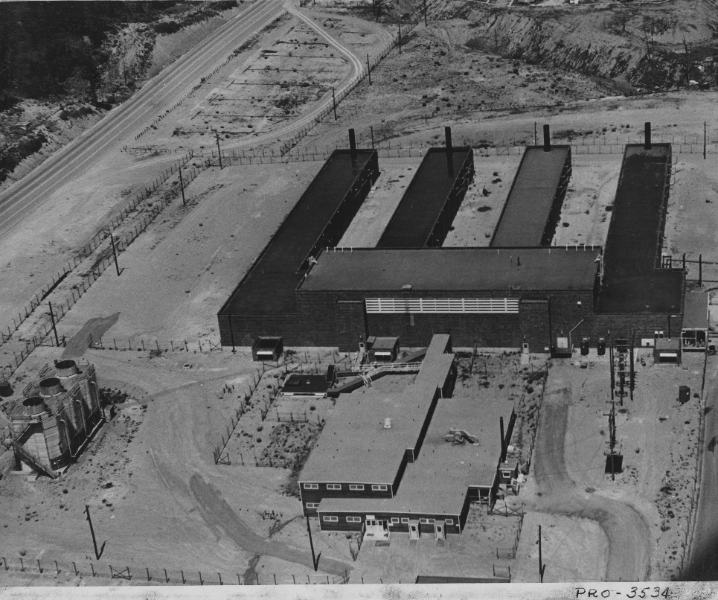
Y-12 Facilities Today
Ongoing Operations in Legacy Facilities

Slide 12
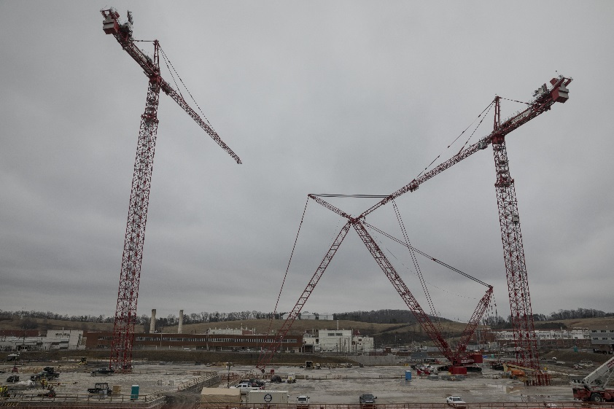
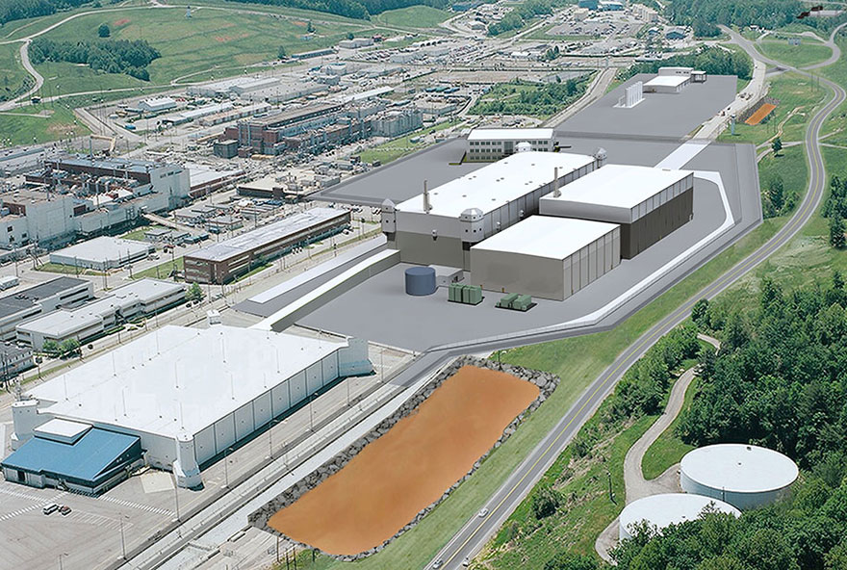
New Y-12 Facilities
Storage - HEUMF
Processing - UPF
Notes:
New facilities in backdrop of legacy facilities

Slide 13
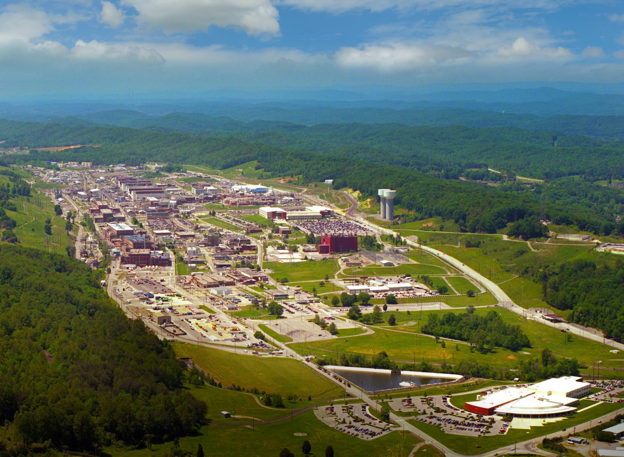
Y-12 Today
811 acres spanning 2.5 miles, 150 high-security acres
7.3 million ft² of laboratory, machining, dismantlement, research and development and office areas
343 buildings, 13 mission-critical facilities
1.4 million ft² demolished
Notes:
Acreage and facility square footage

Slide 14
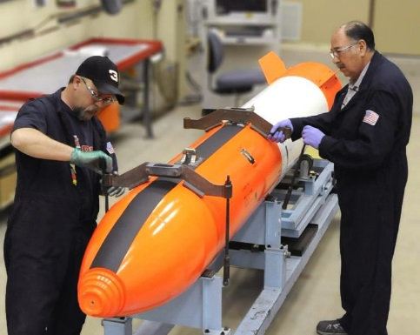

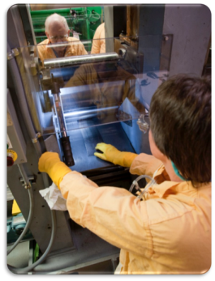
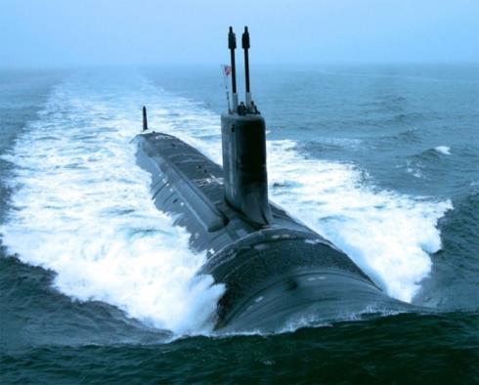
Y-12’s Missions
Deterrence — produce, maintain and protect essential materials and components for the U.S. nuclear arsenal
Fuel Supply — provide enriched uranium for naval propulsion, isotope production, research reactors and advanced reactors
Nuclear Security — reduce the threat
of nuclear and radiological terrorism
Notes:
Amid emerging global threats, Y-12 is a key player in the nation’s non-proliferation policies, initiatives and efforts:
I’ve already touched on the core mission of deterrence
A second mission is fuel supply – providing enriched uranium for naval propulsion, isotope production and research reactors.
A third important mission is reducing the threat of nuclear and radiological terrorism by securing vulnerable nuclear material domestically and internationally, training first responders and security personnel, assisting foreign partners on nuclear material security, and contributing to international safeguards and other nonproliferation initiatives.
So let me go into just a bit more detail on each of these.

Slide 15
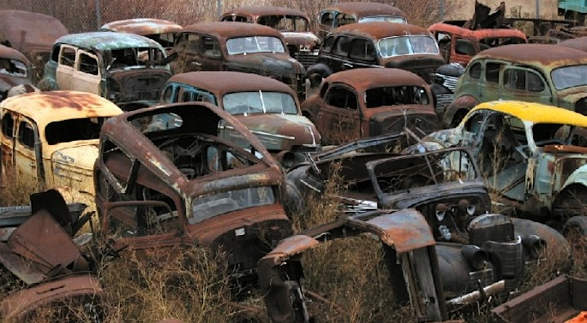

Maintaining the Nuclear Weapons Stockpile
Notes:
Contrast between vintage cars that are not maintained and those that are properly cared for

Slide 16
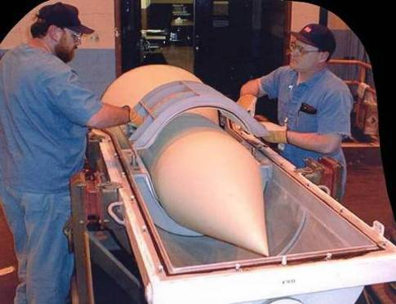
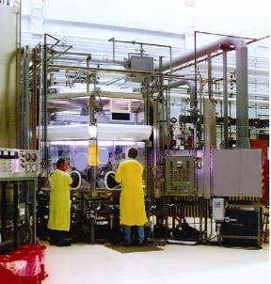
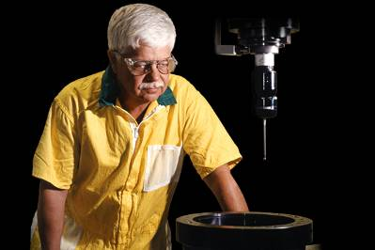
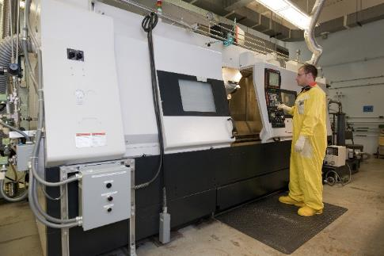
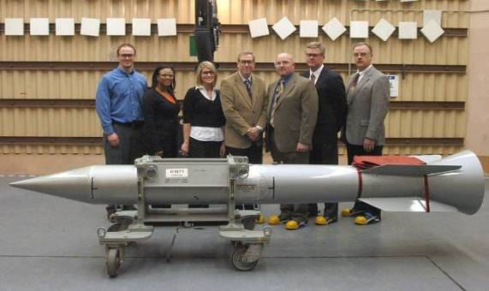
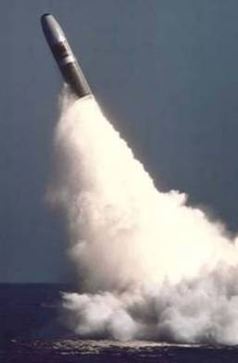
Sustain the U.S. Nuclear Deterrent
Ensuring a Safe, Secure, and Reliable Nuclear Deterrent
Disassembling Weapons
Evaluating Components
Testing Hardware
Producing Life Cycle Components
Refurbishing Weapons
Notes:
16
While the U.S. is working towards disarmament by reducing its weapons stockpile, as long as there are nuclear weapons in the world, the U.S. need to maintain a viable nuclear deterrent.
This involves ensuring that the weapons stockpile remains safe, secure and viable.
Work at Y-12 in this regard involves dismantling weapons, testing components and refurbishing systems.
Y-12 has built components for every nuclear weapon that has ever been in the U.S. stockpile for the last 70+ years.

Slide 17
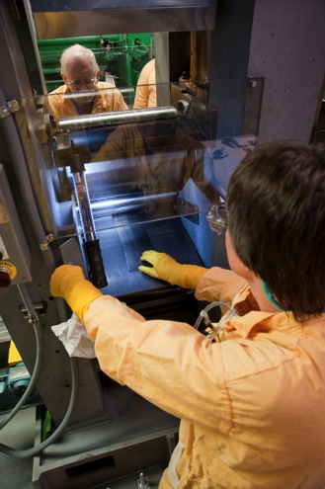
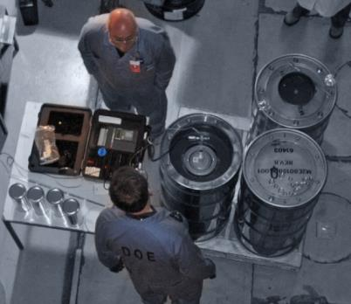
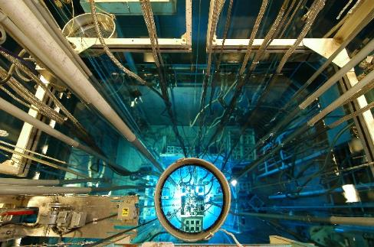
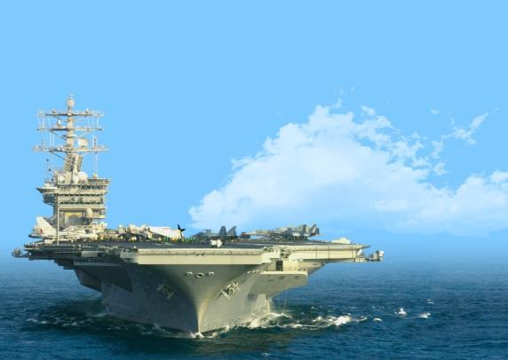
Nuclear Technology & Materials
Supply Enriched Uranium Fuel
Converting HEU Fueled Research Reactors
Supplying LEU for Research Reactors
Supplying HEU to the U.S. Navy
Producing High Density LEU Alloy Fuel for HEU Reactor Conversions
Notes:
A second mission is fuel supply
Y-12 has been supplying enriched uranium feedstock for research reactor fuel since Atoms for Peace program began in mid 1950s
There has been a big non-proliferation program in the U.S. in the last 10+ years to help countries convert their HEU-fueled research reactors to low-enriched uranium fuel.
To support that effort, Y-12 has been leading the way in developing the production processes for making high-density metallic fuel from LEU and molybdenum; very dense fuel is required to produce the high neutron flux comparable to HEU fuel.
Y-12 also provides material for the production of medical isotopes including LEU targets [using high density Umo for Mo99 production]
Y-12 is also conducting work to advance new commercial and government nuclear reactor fuels for advanced reactor types.
And Y-12 in the only supplier of HEU for the U.S. Naval Reactors program, for fueling some 103 naval reactors on aircraft carriers and nuclear submarines; since the U.S. no longer produces high enriched uranium, the material comes from former nuclear weapons.

Slide 18
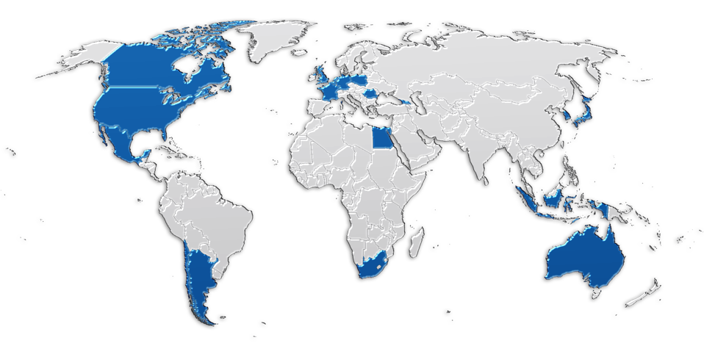

Research Reactors Supplied from Y-12
Netherlands
Germany
Canada
Belgium
Poland
Romania
United States
France
South Korea
Japan
Egypt
Indonesia
Australia
Chile
Argentina
South Africa
Notes:
Here’s a snapshot of the major research reactor customers that Y-12 supplies material for (either as fuel or for targets for medical isotope production: Argentina, Australia, Belgium, Canada, Egypt, France, Japan, The Netherlands, Romania and South Korea
[The low-enriched uranium (LEU) is produced from downblending highly enriched uranium (HEU) with natural or depleted uranium to 19.75% f²³⁵U. This is one of the disposition paths for the Surplus HEU Disposition Program.]
Excluding the Russian research reactors, Y-12 provides the enriched uranium feedstock for over 80% of the research reactors in the world.

Slide 19
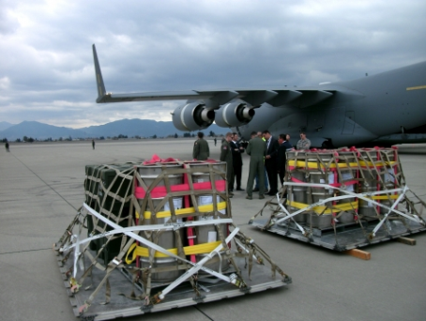
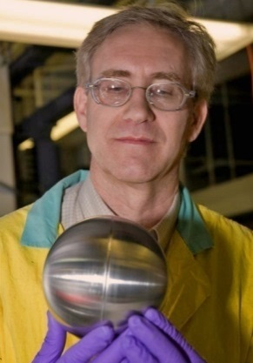
Reduce the Global Nuclear Threat
Detect uranium and the proliferation of weapons of mass destruction
Secure nuclear materials globally
Train and test security forces and systems
Radiological Signature
Training Device
HEU being returned from Mexico
Notes:
The third mission area is nuclear security, specifically by
Developing detection capabilities
Recovering and securing nuclear material from facilities and activities around the world that are a potential proliferation concern
Downblending HEU to LEU and using it for peaceful purposes
Training those responsible for security and testing security system performance

Slide 20
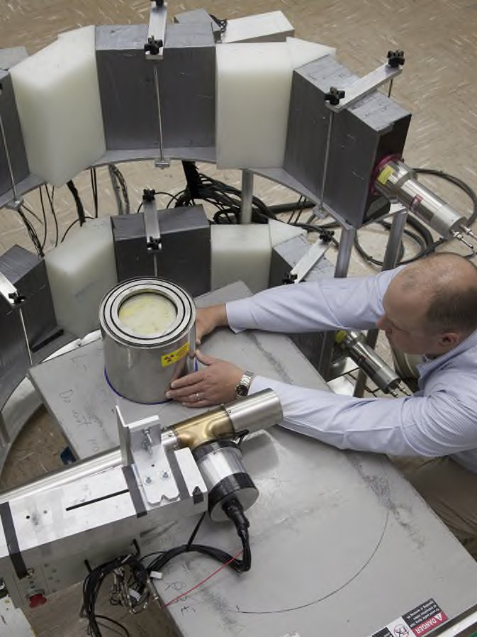
Reduce Nuclear Threats: Develop Detection Capabilities
Y-12’s Nuclear Detection and Sensor Testing Center (NDSTC) allows researchers to deploy and test instrumentation using uranium in a wide variety of forms and enrichment, including HEU
Testing of Active Interrogation Nuclear Detection Equipment
University of Michigan NERS Measurements
Notes:
Y-12’s Nuclear Detection and Sensor Testing Center provides researchers with dedicated facilities to test radiation sensors, detector instrumentation and analytical techniques.
The NDSTC supports proliferation detection, nuclear safeguards, emergency response, treaty verification and university research.
Two testing areas:
One is a highly secure facility that has large quantities of HEU for testing purposes with different configurations (with different moderators, reflectors, shielding)
A second one with smaller quantities of uranium in a wide variety of forms and enrichments from depleted to HEU - this lab is open to students, instrumentation companies, researchers including foreign nationals.
Y-12 is conducting research in uranium processing to enhance understanding of signatures and observables for proliferation.
In partnership with other laboratories, Y-12 is developing detection algorithms to support material monitoring.

Slide 21
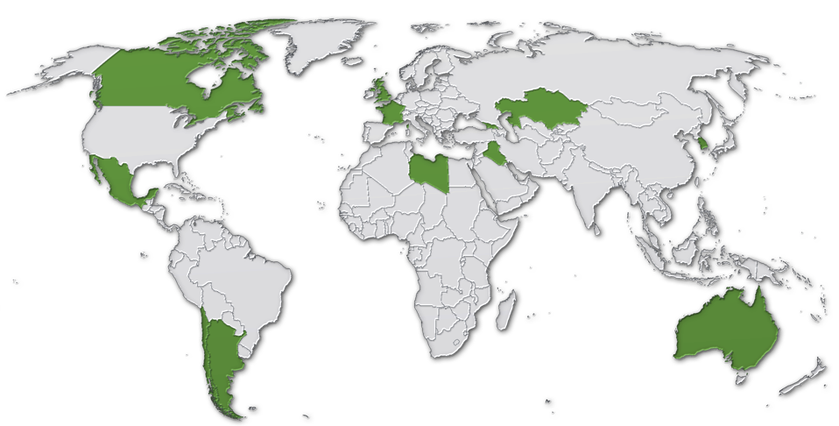
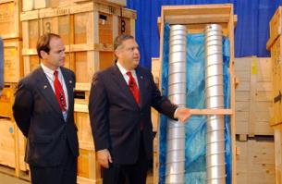
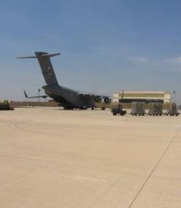
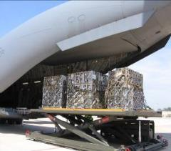
Reduce Nuclear Threats: Recover and Secure Nuclear Material
Canada
Great Britain
Georgia
France
Kazakhstan
Libya
Iraq
South Korea
Mexico
Australia
Chile
Argentina
Notes:
Y-12 leads rapid material recovery missions – to reduce potential proliferation threats.
Since 1994, we’ve been involved in some 20 international missions, most recently in Japan and the UK.
Y-12 is presently working in a number of other countries planning future missions for the return and disposition of HEU.
Over the years there have been some very high-profile recovery missions involving collaborative efforts of Y-12 with other orgs/agencies; here’s a picture of centrifuges recovered from Libya in 2005/6 (centrifuges procured from the clandestine A.Q. Khan network)

Slide 22
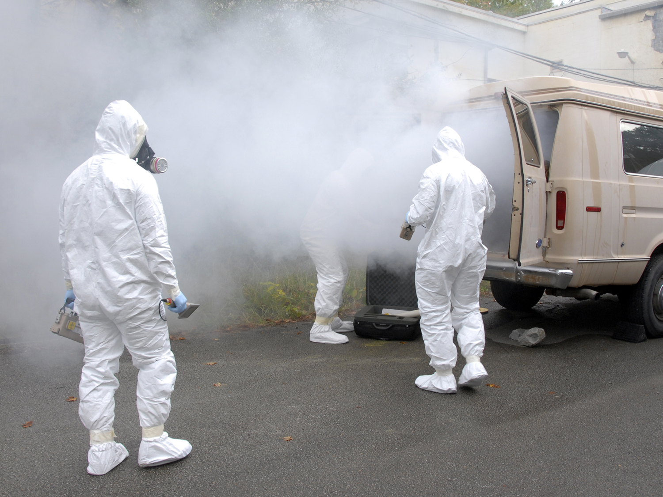
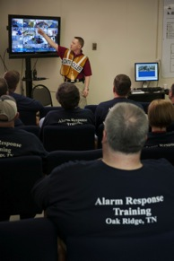
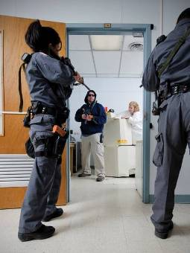


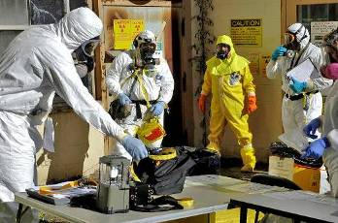

Reduce Nuclear Threats: Security Training & Testing
Real-world training and testing to protect our world
Notes:
Leveraging our expertise in safety, security, assessments, etc to support this activity
Develop a Training Campus that supporting Civil support teams, DIA, DTRA, state, local organization DOE/NNSA, international
Train and test security forces and systems
Alarm Response Training
Training those responsible for safeguarding radiological sources and nuclear materials used in medical procedures, university research, and research reactors.
Security Performance Testing
Supporting Safeguards and Security sustainability in other countries
Training of foreign partners in Y-12 facilities on how to better handle and safeguard nuclear materials
Nuclear & Radiological Field Training
Training Department of Defense, Department of Homeland Security, Department of Justice, and other government agency first responders on how to handle and find real nuclear and radiological materials

Slide 23
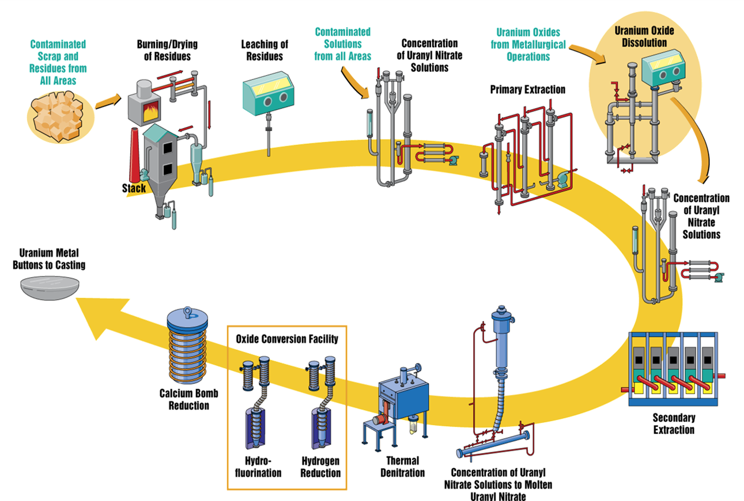
Chemical Recovery at Y-12

Slide 24



Uranyl Nitrate Solution

Slide 25

Processes at Y-12

Slide 26



Processes at Y-12

Slide 27


Machining

Slide 28
Assembly

Slide 29



Uranium Storage System
https://www.youtube.com/watch?v=wgEvNc-qQ0M

Slide 30

Uranium Processing Facility (UPF)

Slide 31
UPF Main Process Building (MPB)
Casting
Break & Shear
Sampling
Receipt & Packaging
Pickling
Microwave casting
Cast parts
Packaged metal for
off-site shipment
Uranium Metal Feeds
Spent tooling & insulation
for waste disposition
New tooling & insulation
Oxide
Uranium Oxide
HEU Pickling solution
Broken metal
& skull metal
Misc. Alloys & U-bearing materials
SOX
Oxide Material Production (OMP)
Dissolution
Precipitation
Conversion
Sintering
Sizing & Packaging
Bulk Metal Oxidizer
SOX
Special Material Production (SMP)
- Dissolution
- Purification
- Calcination
- Sampling &Packaging
Uranium Oxide
Aqueous salvage streams
Specialty oxide products
for off-site shipment
Purified oxide product

Slide 32
Salvage and Accountability Building (SAB)
LEU Pickling solution
Leaching
Misc. U-bearing solids
Depleted uranyl nitrate
Misc. aqueous
salvage solutions
Recovery
Evaporator
Calciner
LEU impure oxide
Concentrated Solution
Condensate
Spent scrubber solution
Waste Water
aqueous
waste
disposition
Salvage solution
Decontamination
Facility
Misc. contaminated
Items
Filter & Separation
Misc. aqueous &
organic solutions
Cleaned items for reuse
or waste disposition
Liquid solutions for waste disposition

Slide 33



Deactivation

Slide 34

The Nuclear Criticality Hazard
The release of energy as the result of inadvertently producing a self-sustaining or divergent chain reaction
22 documented (known) process criticality accidents
  21 involving solution/slurry
  1 involving metal ingots
By Country
  7 United States
  1 United Kingdom
  1 Japan
  13 in the Former Soviet Union
9 deaths
  2 United States
  2 Japan
  5 Former Soviet Union
3 personnel required limb amputations

Slide 35

The Nuclear Criticality Hazard
1958 Criticality Accident
  Multiple pulses
  Eight significant exposures
  Maximum Dose 461 rem

Slide 36


NCS Engineer Responsibilities
Unevaluated Conditions
○
Credible Abnormal Conditions
Writing Criticality Safety Evaluations
○
○
+
+
○
○
Normal Conditions
+
+
○
○

Slide 37

NCS Engineer Responsibilities
Reviewing Implementing Documents
  Drawings
  Procedures
  Postings
  Many Others

Slide 38


NCS Engineer Responsibilities
Operational Reviews

Slide 39




NCS Engineer Responsibilities
Perform NCS Calculations

Slide 40

Validation
Criticality Calculations
Shielding Calculations

Slide 41

Packaging

Slide 42

Criticality Accident Alarm System (CAAS)
Detector Placement
Evacuation Zone Determination

Slide 43



Other NCS Responsibilities at Y-12
Abnormal Condition Response
Emergency Response
Program Assessments

Slide 44

Questions

Slide 45
Disclaimer
This work of authorship and those incorporated herein were prepared by Consolidated Nuclear Security, LLC (CNS) as accounts of work sponsored by an agency of the United States Government under Contract DE‑NA0001942. Neither the United States Government nor any agency thereof, nor CNS, nor any of their employees, makes any warranty, express or implied, or assumes any legal liability or responsibility to any non‑governmental recipient hereof for the accuracy, completeness, use made, or usefulness of any information, apparatus, product, or process disclosed, or represents that its use would not infringe privately owned rights. Reference herein to any specific commercial product, process, or service by trade name, trademark, manufacturer, or otherwise, does not necessarily constitute or imply its endorsement, recommendation, or favoring by the United States Government or any agency or contractor thereof. The views and opinions of authors expressed herein do not necessarily state or reflect those of the United States Government or any agency or contractor (other than the authors) thereof.

